Slide 1
ABCD Files & Messages Workshop: Ontology Break-Out Session
14 Jun 2012
David Pack
Program Director, Condition-Based Management Plus (CBM+), Fleet Planning & Fleet Management
Strategic Sustainment Support Office
CECOM Logistics & Readiness Command
Aberdeen Proving Ground, MD 21005
Anthony Petosa, CBM+ SEC Ontology Technical Lead
Pamela Ludwig, CBM+ SEC Lead
Software Engineering Center
Army Net-Centric Data Strategy Center of Excellence
Aberdeen Proving Ground, MD 21005

Slide 2
Agenda
Welcome
Bottom Line, Up Front
What Is Ontology & Why Use It?
Prerequisites
Goals
Phased Development
Current Status
Summary
Open Session Discussion

Slide 3
Welcome

Slide 4
BLUF
Build a CBM+ domain ontology to effect meaningful information sharing
Requires active SME participation

Slide 5
What Is Ontology?
Derived from ancient Greek (onto-: “being; that which is” and -logia: “science, study, theory”)¹
“Ontology is the philosophical study of the nature of being, existence or reality as such, as well as the basic categories of being and their relations.”¹
¹ “Ontology”, http://en.wikipedia.org/wiki/Ontology

Slide 6
Why Use Ontology?
Ontology is a critical enabler for conversing and exchanging information with semantic clarity
Practically speaking:
Ontology is useful for defining terms and their interrelationships in some Universe of Discourse (i.e., some “domain”)
Purpose is to convey terms and their meanings with the same intent universally across the Army Materiel Command and beyond
Aristotelian view of ontology:
Observe what exists in nature as it exists in nature (take a scientific approach)
Purpose is to disassociate from a human-centric view of reality as best as is practicable
Promotes semantic interoperability

Slide 7
Prerequisites
CBM+ Domain Ontology: Prerequisites
Domain documentation
RCM, CBM, CBM+, and Logistics subject matter experts (SMEs)
Active SME participation within an incremental ontology development effort

Slide 8
Goals
CBM+ Domain Ontology: Goals
Increase semantic clarity in the CBM+ domain
Build small initially, keeping extensibility in mind
Document current semantic gaps and lessons learned
Define a mitigation strategy to close gaps
Build & engineer taxonomy(ies) ontology(ies) in OWL-DL
Synchronize with Basic Formal Ontology (BFO)
To the degree possible, ensure the OWL-DL set-theoretic “logical form” reflects the “ontological form”

Slide 9
Phased Development
CBM+ Domain Ontology: Phased Development
Terminology Scoping Phase
Vocabulary Development Phase
Taxonomy Development Phase
Ontology Development Phase

Slide 10
Terminology Scoping Phase
1.
Acquire Some Domain Knowledge (Ontologist)
2.
Identify Domain SMEs
3.
Data Call
4.
Refine Terminological Scope
I. Gather Domain Terms
III. Complete Terminology Scoping
II. Collaborate Iteratively
Set of Domain Terminology
Semantics Knowledge (Ontologist)
Domain Knowledge (SME)

Slide 11
Vocabulary Development Phase
1.
Initial Set of Scoped Terms
2.
Identify Domain SMEs
3.
a. Review Existing Definitions
b. Review Proposed Definitions for Proposed Terms
I. Begin with Scoped Terms
III. Complete Vocabulary
II. Collaborate Iteratively
Domain Vocabulary
Semantics Knowledge (Ontologist)
Domain Knowledge (SME)

Slide 12
Taxonomy Development Phase
1.
Domain vocabulary
2.
Identify Domain SMEs
3.
Categorize Terms Hierarchically Based Upon BFO Principles
I. Begin with Vocabulary
III. Complete Taxonomy
II. Collaborate Iteratively
Domain Taxonomy
Semantics Knowledge (Ontologist)
Domain Knowledge (SME)

Slide 13
Ontology Development Phase
1.
Domain Taxonomy
2.
Identify Domain SMEs
3.
Build Ontology Based Upon BFO Principles
I. Begin with Taxonomy
III. Complete Ontology
II. Collaborate Iteratively
Domain Ontology
Semantics Knowledge (Ontologist)
Domain Knowledge (SME)

Slide 14
Current Status
Terminology scoping phase near completion
Seeking additional SMEs for upcoming vocabulary development phase
Development timeline: mid-Jun to mid-Jul 2012
Highly iterative process requires SME availability

Slide 15
Summary
CBM+ domain ontology will focus on an initial set of SME-vetted, relevant domain terminology
Cannot be accomplished successfully without active SME participation

Slide 16
Open Session Discussion

Slide 17
Backup

Slide 18

Ontology Is a Critical Enabler [1/2]
Ontology is a critical enabler for conversing with semantic clarity
A Notional Conversation…
What is CBM+?
Ontologist
CBM+ is a set of maintenance processes and capabilities derived primarily from real-time assessment of weapon system condition obtained from embedded sensors and/or external test and measurements using portable equipment.¹
√
(almost)
SME #1
Condition-based maintenance (CBM) is a maintenance strategy that is derived from an RCM analysis. CBM encompasses a set of maintenance processes and capabilities derived from real-time assessment of weapon system condition obtained from embedded sensors and/or external test and measurements using portable equipment. The goal of CBM is to perform maintenance only upon evidence of need. See AR 750-1 or further guidance.²
Is CBM+ a “set of processes”? A “maintenance strategy”? The “application and integration of appropriate processes…”?
SME #2
X
Assumption made that SME #1 offers the closest definition. Still, it is not quite accurate from an ontological perspective.
SME #3
Condition Based Maintenance Plus (CBM+) is the application and integration of appropriate processes, technologies, and knowledge-based capabilities to improve the reliability and maintenance effectiveness of DoD systems and components.³
X
¹ “Army Materiel Maintenance Policy”, AR 750-1, HDA, 20 Sep 2007.
² ”Integrated Logistics Support”, AR 700-127, HDA, 29 Apr 2009.
³ “Condition Based Maintenance DoD Guidebook”, DSD(U) LMR, May 2008.

Slide 19
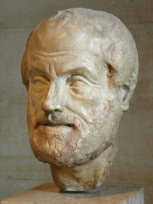
Ontology Is a Critical Enabler [2/2]
Ontology is a critical enabler for conversing with semantic clarity
A Notional Conversation…
New CBM+ Definition
Condition Based Maintenance Plus (CBM+) is a set of maintenance processes primarily derived from real-time equipment assessment.
√
CBM+ “is a set of maintenance processes and capabilities…”.
Does not CBM+ also apply to industry? If so, then the phrase “weapon system” in the AR 750-1 definition is scoped narrowly.
How CBM+ is implemented (i.e., via embedded sensors and/or external test and measurements using portable equipment) is distinct from what CBM+ “is”.
CBM+ is “derived primarily from real-time assessment…”. This implies CBM+ also derives from something else. What is that “something else”?
Ontologist
Aristotle
I concur.
New Terms
WeaponSystem
MaintenanceProcess
MaintenanceCapability

Slide 20
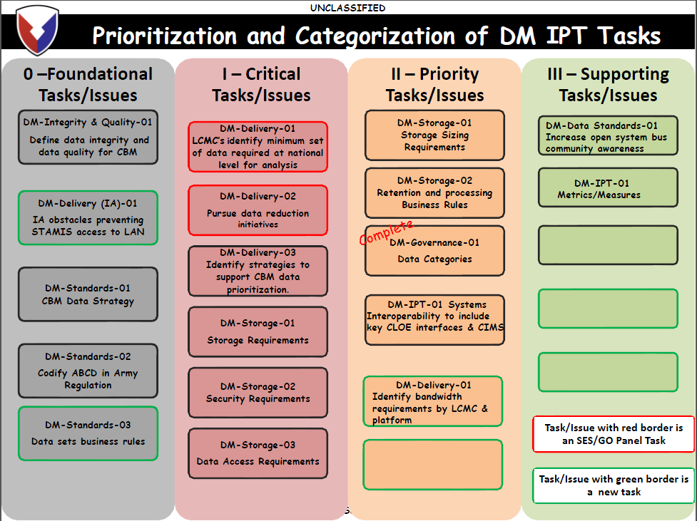
Data Quality Is Foundational
Slide excerpted from “AMC CBM+ DM IPT Summit Out Brief”, LOGSA Enterprise Data Management Office, David A. Smith, 20 Jan 2012.

Slide 21
Semantic Interoperability
Purpose
“Defined CBM file and data message standards needed to synchronize CBM+ data from collection activities into data warehousing for use in Analysis. This includes defining the data elements and meta-data properties that will be collected at or near platform… As the major commands interact with their subsequent PEOs and PMs, which will further interact with their contractor base, there is a need for coherent understanding of data elements and properties.” * (emphasis mine)
Goals
Syntactic interoperability using common syntactic/structural forms (ABCD, XML, etc.)
Semantic interoperability
Create & reuse terms with concise and precise definitions
Terms/definitions meet local needs but extend from broader, well-understood terms
Strive toward human understanding first, then focus on machine “understanding”
AI capabilities pose a whole range of challenges but are meaningless without first achieving human understanding of a domain
Excerpted from “TACOM ILSC CBM+ Files and Messages Workshop Out Briefing”, TACOM LCMC, 15 Sep 2011, Slide #2.

Slide 22
Common Semantic Trap
Purpose is to disassociate from a human-centric view of reality as best as is practicable – a Data Quality issue
For example, what is a Maintainer?
AV-2 Definition
“Individual responsible for performing maintenance on equipment. Maintainers normally diagnose down to the major component failure. They then replace that component and return the system to operational condition.”
Notional Definition
“A Maintainer is a Role that is responsible for performing equipment maintenance.”
The notional definition is concise and offers semantic precision
Term is reusable for any “agent” (human or machine) that plays this role
Descriptive component is removed from the definition. Descriptions are useful in supporting definitions, but they must not be contained within definitions.
Descriptive component may suggest additional domain terms, as in “MaintainerFunction”, to define the purpose a Maintainer role innately holds

Slide 23
Reference Documentation
AMC Condition-Based Maintenance Plus (CBM+) Implementation Plan v1.0, 05 Feb 2010.
Maintenance of Supplies and Equipment Army Materiel Maintenance Policy, AR 750-1, Headquarters, Department of the Army, Washington, D.C., 20 Sep 2007.
Enterprise Architecture Based on Design Primitives and Patterns: Guidelines for the Design of the Integrated Dictionary (DoDAF AV-2), Business Transformation Agency, 21 May 2009.
CBM+ Ontology Progress Report for the Ontology Development Integrated Product Team, 07 Mar 2008.
Condition Based Maintenance Plus DoD Guidebook, May 2008.
CBM+ 101 – Overview, LogTech.
U.S. Army CBM+ Roadmap, Deputy Chief of Staff, G-4 Headquarters, Department of the Army, 13 Dec 2007.
CBM+ CECOM LCMC LRC Architecture Version 1.0, All View AV-2: Overview and Summary Information, Logistics & Readiness Center, 20 Jan 2011.
CECOM_CBM+_ARCH_AV-2_DataDictionary.xlsx (Excel file)
Final Signals List.xls (Excel file from IMPACT)
RCM Technical Manuals TM-5-698-1 through TM-5-698-6, Headquarters, Department of the Army, various dates.

